Slide 1
Configuration Guide
(Web Server – WebtoB 4.1)
2009. 07. 21
CODELABOR
Shin Sang Jae (codelabor@gmail.com)

Slide 2
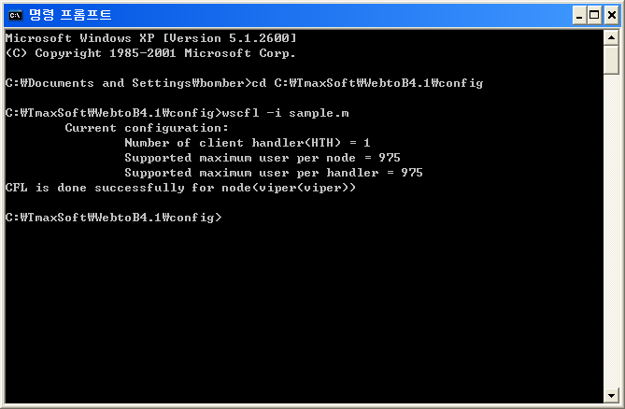
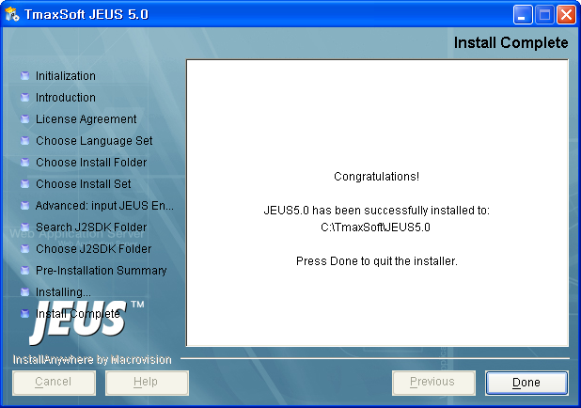
WebtoB
Compile Configuration
Move Config Directory
Config Directory: C:\TmaxSoft\WebtoB4.1\config
Command: wscfl –I sample.m

Slide 3
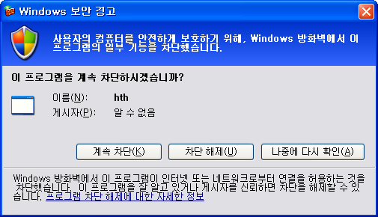
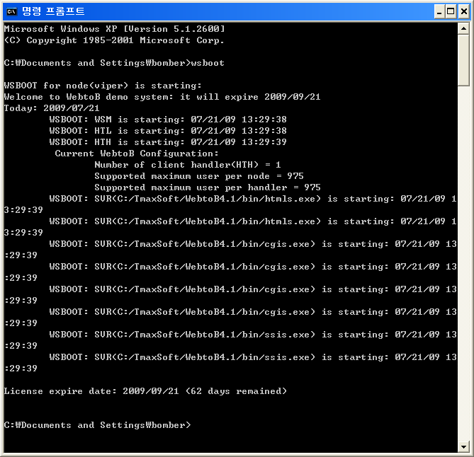

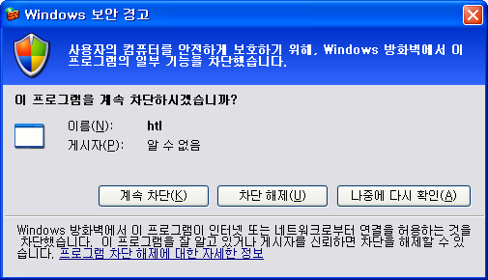
WebtoB
Compile Configuration
Run WebtoB
Command: wsboot
Allow Firewall

Slide 4
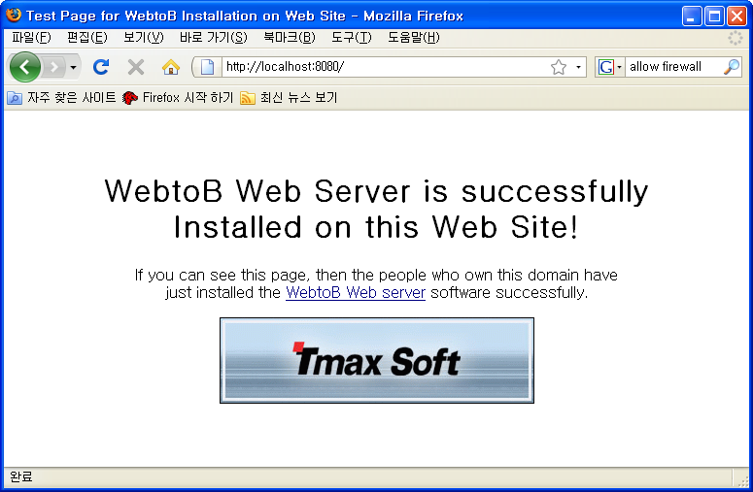
WebtoB
Compile Configuration
Browse Site
URL: http://localhost:8080

